Slide 1

Covid-19 Trends in the U.S. and Illinois
Xi Zhang
Adam Maksimovich
Rob Welling

Slide 2
Motivation & Investigative Summary
Motivation: Given the current semi-locked down status of the world, we were interested in analyzing the relationship between COVID-19 infection rates and individual travel behaviors, specifically within the United States and more locally, Illinois. While travel in all forms has undoubtedly decreased since the beginning of the pandemic, we were curious to analyze how travel patterns have differed regionally across the U.S. during the pandemic and how changes in travel have varied with COVID-19 infection data. Additional factors that we chose to review against COVID-19 infection rates were a county’s population and median household income.
Questions relating to travel and COVID-19 infection rates:
How does daily trips, at a national level, relate to the spread of COVID-19?
How does the frequency or total cumulative daily trips for a region correlate with COVID-19 infection rates?
How does the population of a region impact COVID-19 infections?
Does the median income of a region impact COVID-19 infections?

Slide 3
Questions & Data Sourcing
Each question we chose to investigate was centered around daily COVID-19 cases and the relation toa few specific variables. We were able to source specific sets of publicly available data pertaining to each variable of interest:
Daily Travel Statistics
We luckily stumbled upon the Bureau of Transportation Statistics website which has been aggregating travel data on a daily basis for all counties within the U.S.
Trips are calculated as “…movements that include a stay of longer than 10 minutes at an anonymized location away from home… Trips capture travel by all modes of transportation. including driving, rail, transit, and air.”
Trip data is collected via “… mobile device data panel from merged multiple data sources” and “… only includes mobile devices whose anonymized location data meet a set of data quality standards.”
County Population Data
The U.S. Census Bureau has widely available population estimates that are updated annually
County Household Median Income
The U.S. Census Bureau’s American Community Survey (ACS) surveys income data and is available at the county level
COVID-19 Infection Rates
The CDC as well as USA Facts.org collect daily COVID-19 infection and mortality data at the county level

Slide 4
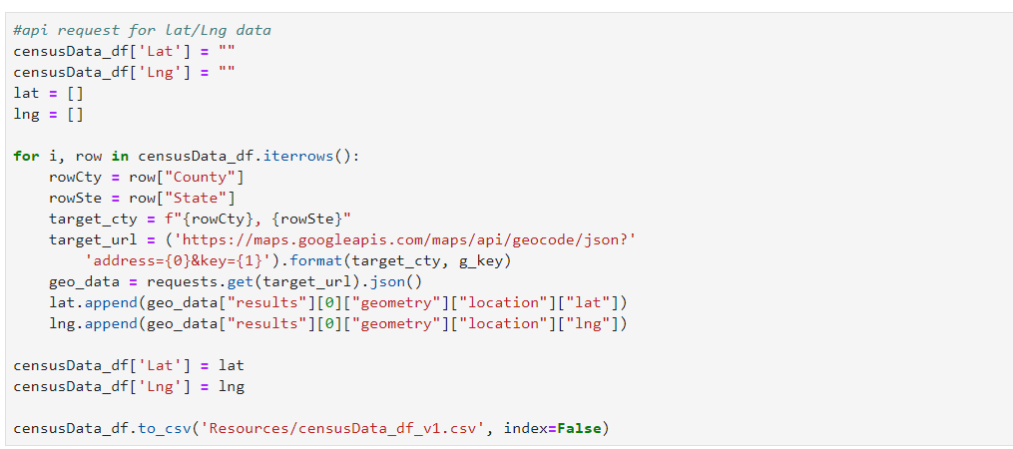
Questions & Data Sourcing
Geographic Location
Google’s geocode API was able to return general latitude and longitude for all counties in our analysis

Slide 5
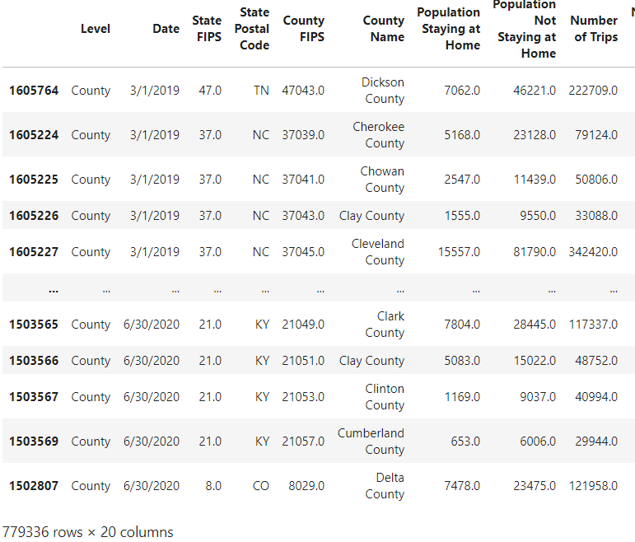
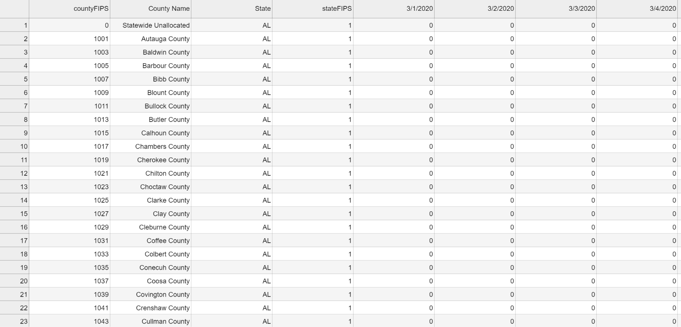
Data Cleanup & Exploration - Xi
Data Sourcing and Cleanup
All the data we use is from county level in order to connect them together. We merged several data sets by utilizing a combination of county OR utilizing a 5 digit county code (FIPS). Then we run into below challenge

Slide 6
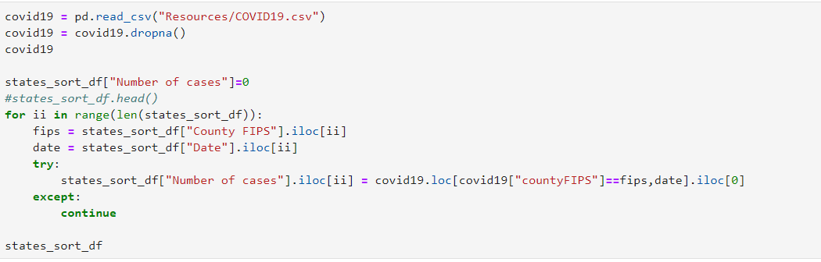
Data Cleanup & Exploration
In order to merge two datasets with different format of “date” information together, we use the “for loop” and “iloc” to find the daily cases information from COVID-19 dataset which was listed in Horizontal and added it to the total traffic dataset.

Slide 7
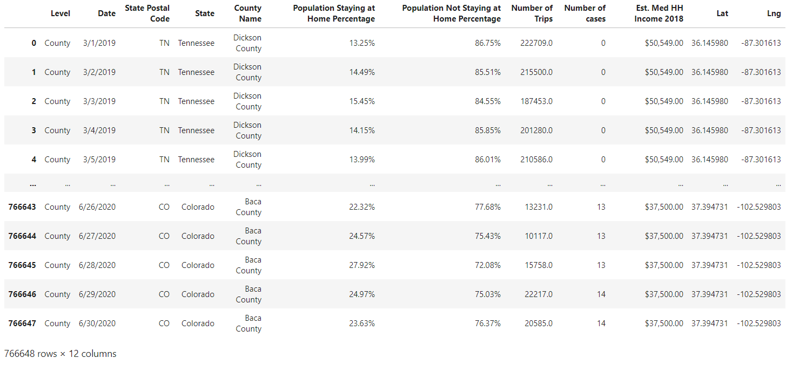
Data Cleanup & Exploration
Below is the results we merged 5 datasets together

Slide 8
Data Cleanup & Exploration
Issues/Insights from Exploring Our Data
After realizing the size of final data, we combine the data by state for higher level analysis and trend identification by utilizing group by functions on the state name and date.
We then parsed out the Illinois data by county into its own data frame which we could use for deeper analysis of the income, population, and location trends.
We also had collected daily data from 2019 to present day at the county level which was initially a hassle to manage (100+ MBs). This presented issues with loading to GitHub and processing on certain machines for specific loops in our clean up code. We ultimately decided to focus solely on 2020 data, and factored in a “control” month (February) where we did not feel travel was ultimately substantially affected by the pandemic.

Slide 9
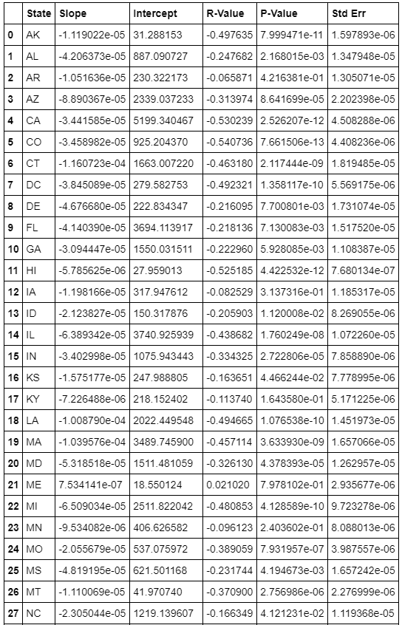
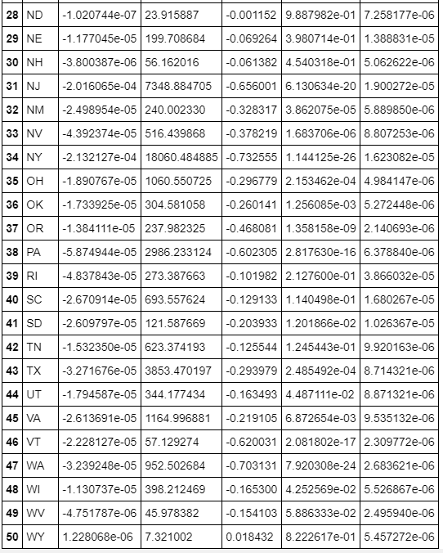
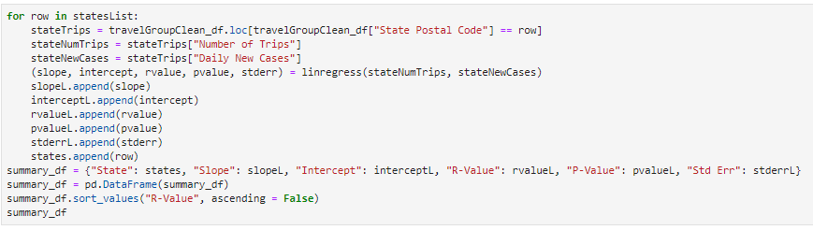
Data Analysis - Adam
Process:
Began our analysis at a State level.
Summary statistics table to illustrate the relationship states have between travel and daily cases.
Drilled down to a focus state
Used Illinois as a test case for measuring the relationship between multiple variables and COVID-19 cases to determine primary driver(s) of COVID-19 cases.

Slide 10
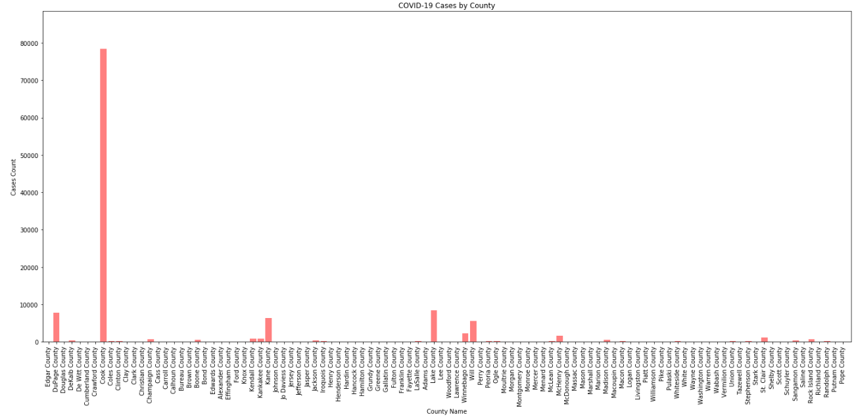
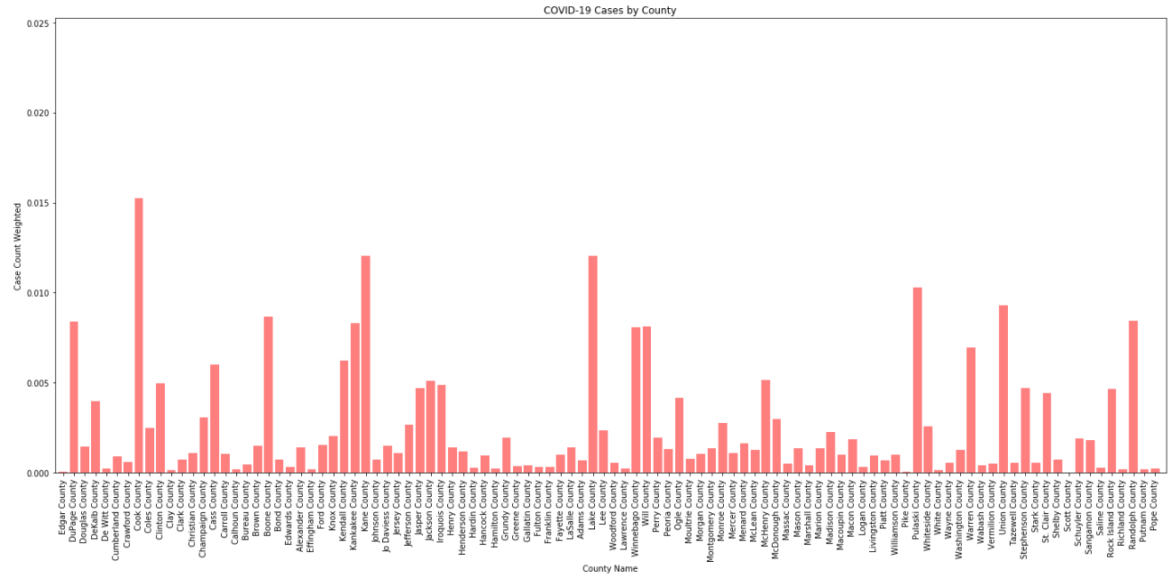
Data Analysis
By raw volume of cases, Cook county has substantially more cases than any other county.
When normalizing the cases by county population, you see that other counties experienced high rates of positive cases:
Kane County
Lake County
Pulaski County
Randolph County
DuPage County
Boone County

Slide 11
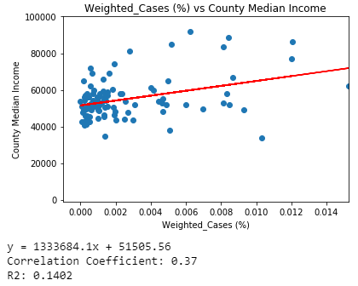
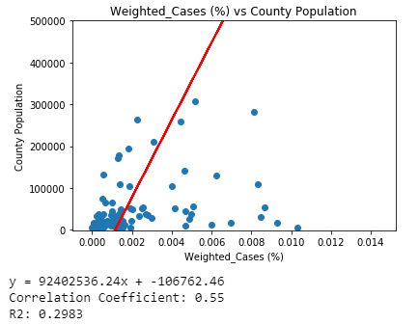
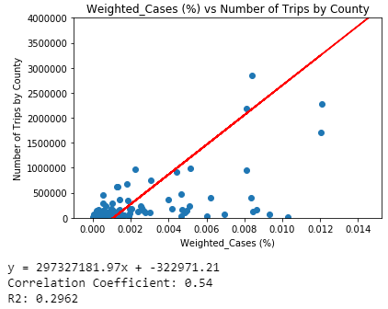
Data Analysis
Certain factors had better relationships to high case rates than others:
County population and number of trips by the citizens of a county were the primary drivers of elevated case rates.
It is interesting to note as county median income increases, cases do increase as well.

Slide 12
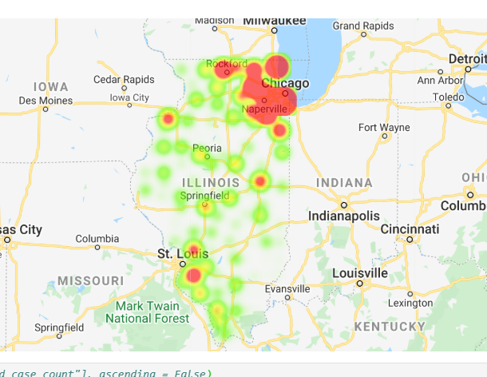
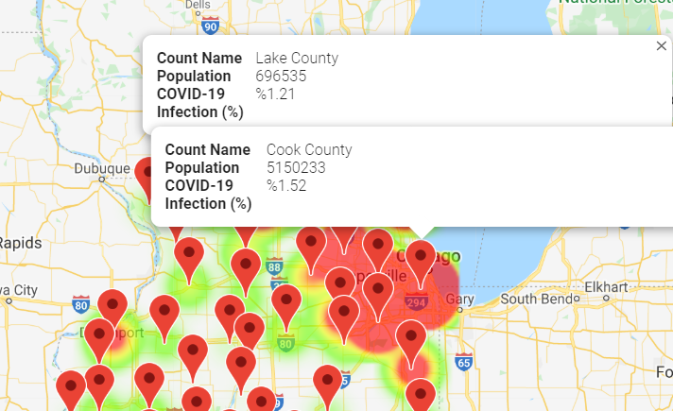
Data Analysis
Geographic factors played a role in COVID-19 cases
Rob to share Jupyter Lab

Slide 13
Discussion
US Travel vs COVID-19 Infections
While we expected a strong positive relationship between daily travel and the rate of infections, our data and regressions actually showed the exact opposite. We believe a few different factors may have led to the inverse relationship:
When the pandemic first began, travel significantly declined with stay at home orders and yet infection rates continued to increase. This initial steep decline in travel with the initial wave of infections may have skewed the results.
There is likely a logical delay between individuals traveling and the manifestation of the COVID-19 infections and their reporting.
IL Median Income and COVID-19 Infections
As people travel more outside their home and interact with other individuals, the relationship suggests that the result will be a rise in COVID-19 cases.
The higher populated cities in Illinois where people are more densely located experience higher case volumes than rural counties where social distancing is easier.
County Median income does have a relationship to the case volume experienced by counties.

Slide 14
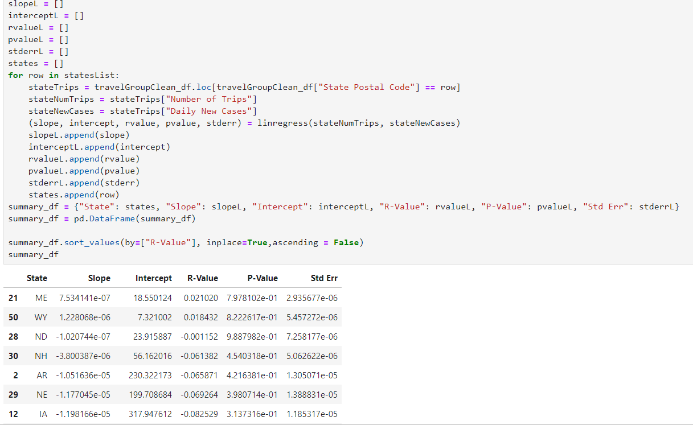
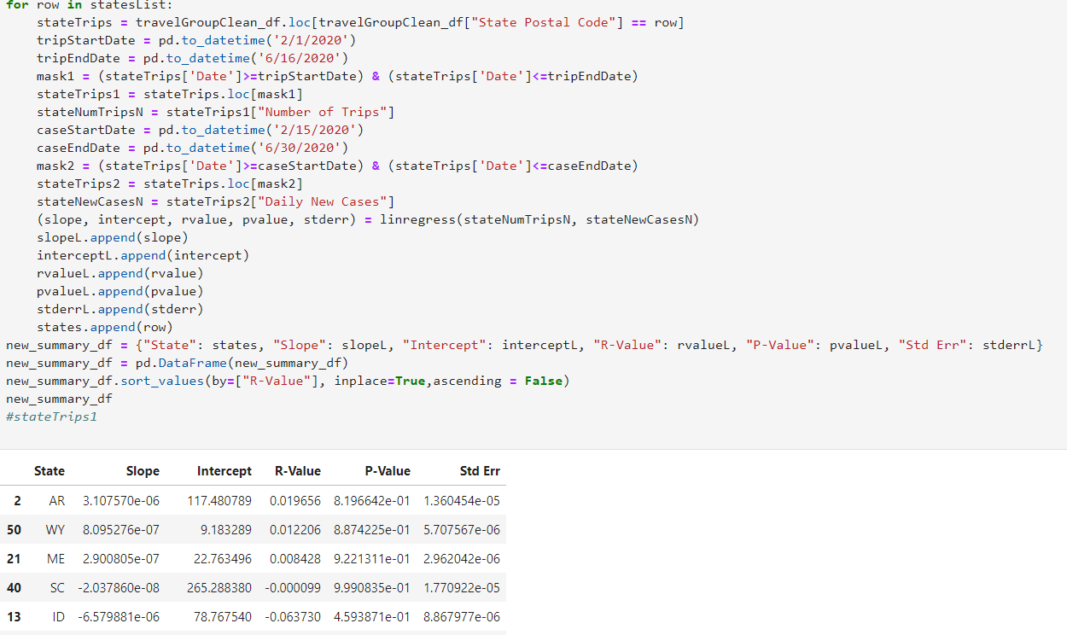
Post Mortem - Rob
Difficulties with our Sourcing and Analysis
Data Sourcing
U.S. Census Bureau – navigating this data source was incredibly confusing and time consuming. They label reports with code sets, use internal links that are unintuitive, and populate data in multiple locations that at times seems redundant
Regressions not meeting our expectations
We were a little frustrated after creating our first series of regressions and finding that travel and infection rates had negative R-Values for nearly every state. This seems to go against our initial hypothesis. We thought it could be a time lag between to total traffic and daily cases, so we calculate the R-Values again between the total daily traffic data and 2 weeks later daily cases data. Still the same trend presented itself.
Additional Questions to be Addressed:
Did counties or states with a greater relative decrease in travel fair any better with COVID-19 infections?
How did median income across the country relate to COVID-19 infections? Were there ‘bands’ within income levels that showed different patterns in COVID-19 infections or travel?

Slide 15
Questions?
Ask away…

